Slide 1


Earth's magnetic field
Measuring the Earth's magnetic field at a given location

Slide 2

Earth's magnetic field
Measuring the Earth's magnetic field at a given location
^{Objetive}
The objective of the activity is to measure the magnetic field of the Earth an a given area. The relation between maximum and minimum values of the magnetic field will be established, and the place where the sensor points to in order to obtain such values.

Slide 3

Earth's magnetic field
Measuring the Earth's magnetic field at a given location
^{Introduction and theory}
Our home, the Earth, has an internal structure which we know little about considering the large number of phenomena associated with its structure and composition. Due to the extreme conditions of pressure and temperature found here, it is easier to learn about distant galaxies than it is to explore the inside of this planet. However, the presence of ferromagnetic materials that are in constant motion with complex dynamics near the Earth’s center, are due to a relatively constant magnetic field. This is however inhomogeneous concerning intensity measured at different points of the Earth's surface. The effects of this field on Earth are dramatic, to the point of being essential to the very existence of life.
What do you understand by magnetic field?

Slide 4
Earth's magnetic field
Measuring the Earth's magnetic field at a given location
^{Introduction and theory}
What action should be run to measure the deflection of a rotating object relative to a starting position?
How does the presence of a magnetic field affect the needle of a compass?

Slide 5
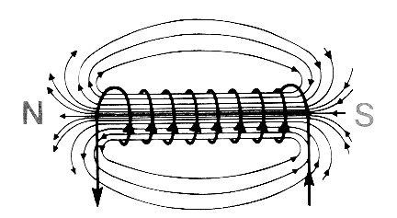
Earth's magnetic field
Measuring the Earth's magnetic field at a given location
^{Introduction and theory}
The lines of magnetic field generated by a coil are present in high concentration per unit area, or intensity along the axis of axial symmetry. This axis defines a dipole, or two ends differentiated by the direction that the lines run through some unit area perpendicular to it. This determines an orientation for magnetic interactions. As according to general convention and European definitions, north - the end of a magnet or coil will act as compass pointing to true north on the planet.
^{Teoría}
( - )
( + )

Slide 6
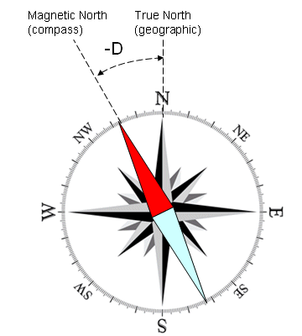
Earth's magnetic field
Measuring the Earth's magnetic field at a given location
^{Introduction and theory}
The corners of Earth are determined by axis and direction of rotation. Thus, the east-west and north-south geographical directions are determined by the movement of the stars. An instrument such as a compass serves for guidance, but does not indicate the exact direction of true north, only in fact the lines of Earth's magnetic field at that location. The inclination of the needle relative to the direction of the rotation axis is an angle called declination, and can take positive or negative values ​​depending on the direction of the inclination.
Magnetic North
(compass)
True North
(geographical)
^{Teoría}

Slide 7
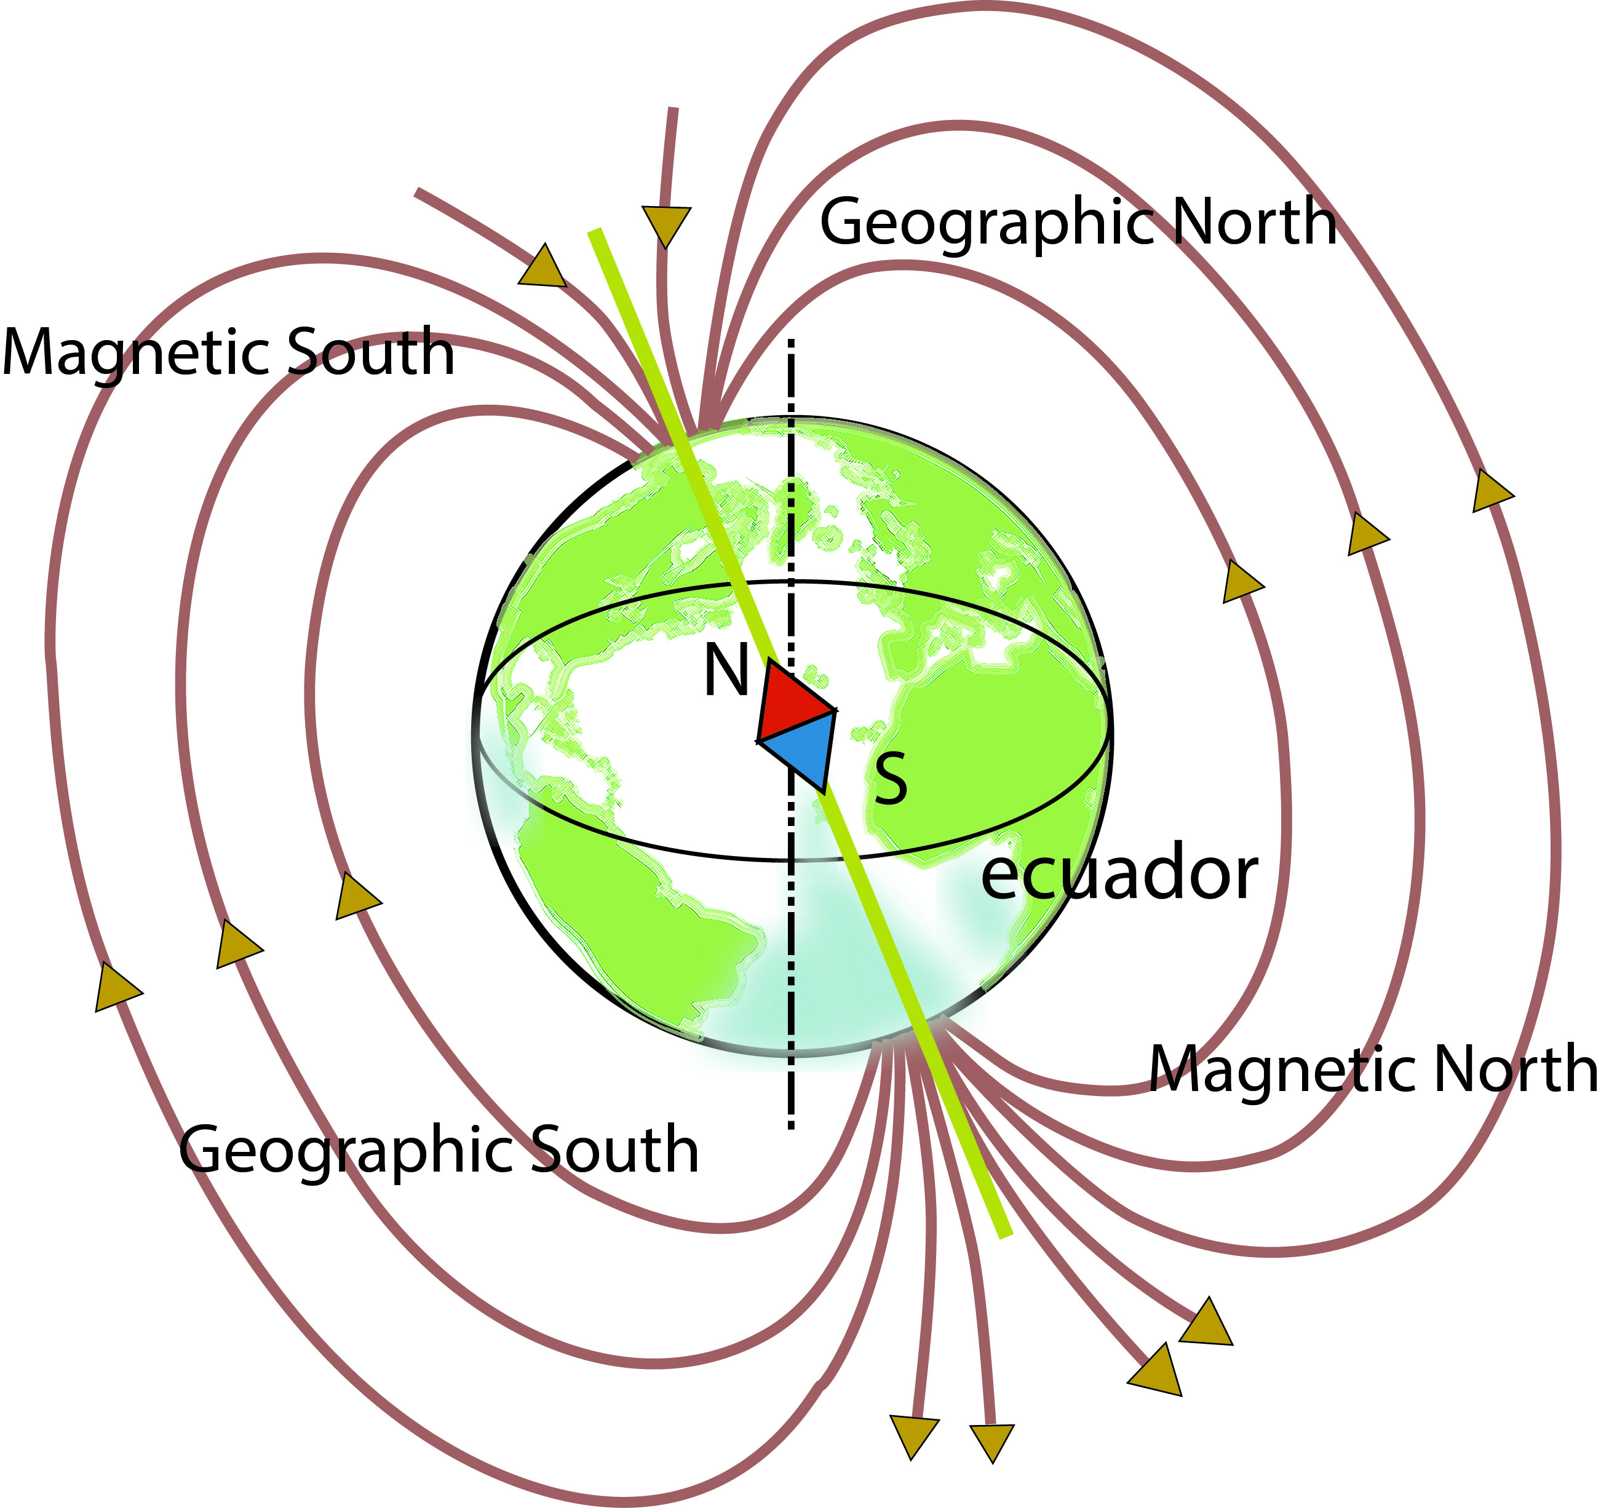
Earth's magnetic field
Measuring the Earth's magnetic field at a given location
^{Introduction and theory}
^{Theoretical}
In this way, and from the observations of Oersted and Faraday, the sense in pointing magnetic field lines at each end of the axis of symmetry or magnetic pole is identified.
According to the European convention for magnetic polarities’ names, it is determined that near the geographic north of the Earth there must be a magnetic south pole, able to attract the north magnetic pole that operates a needle compass.

Slide 8

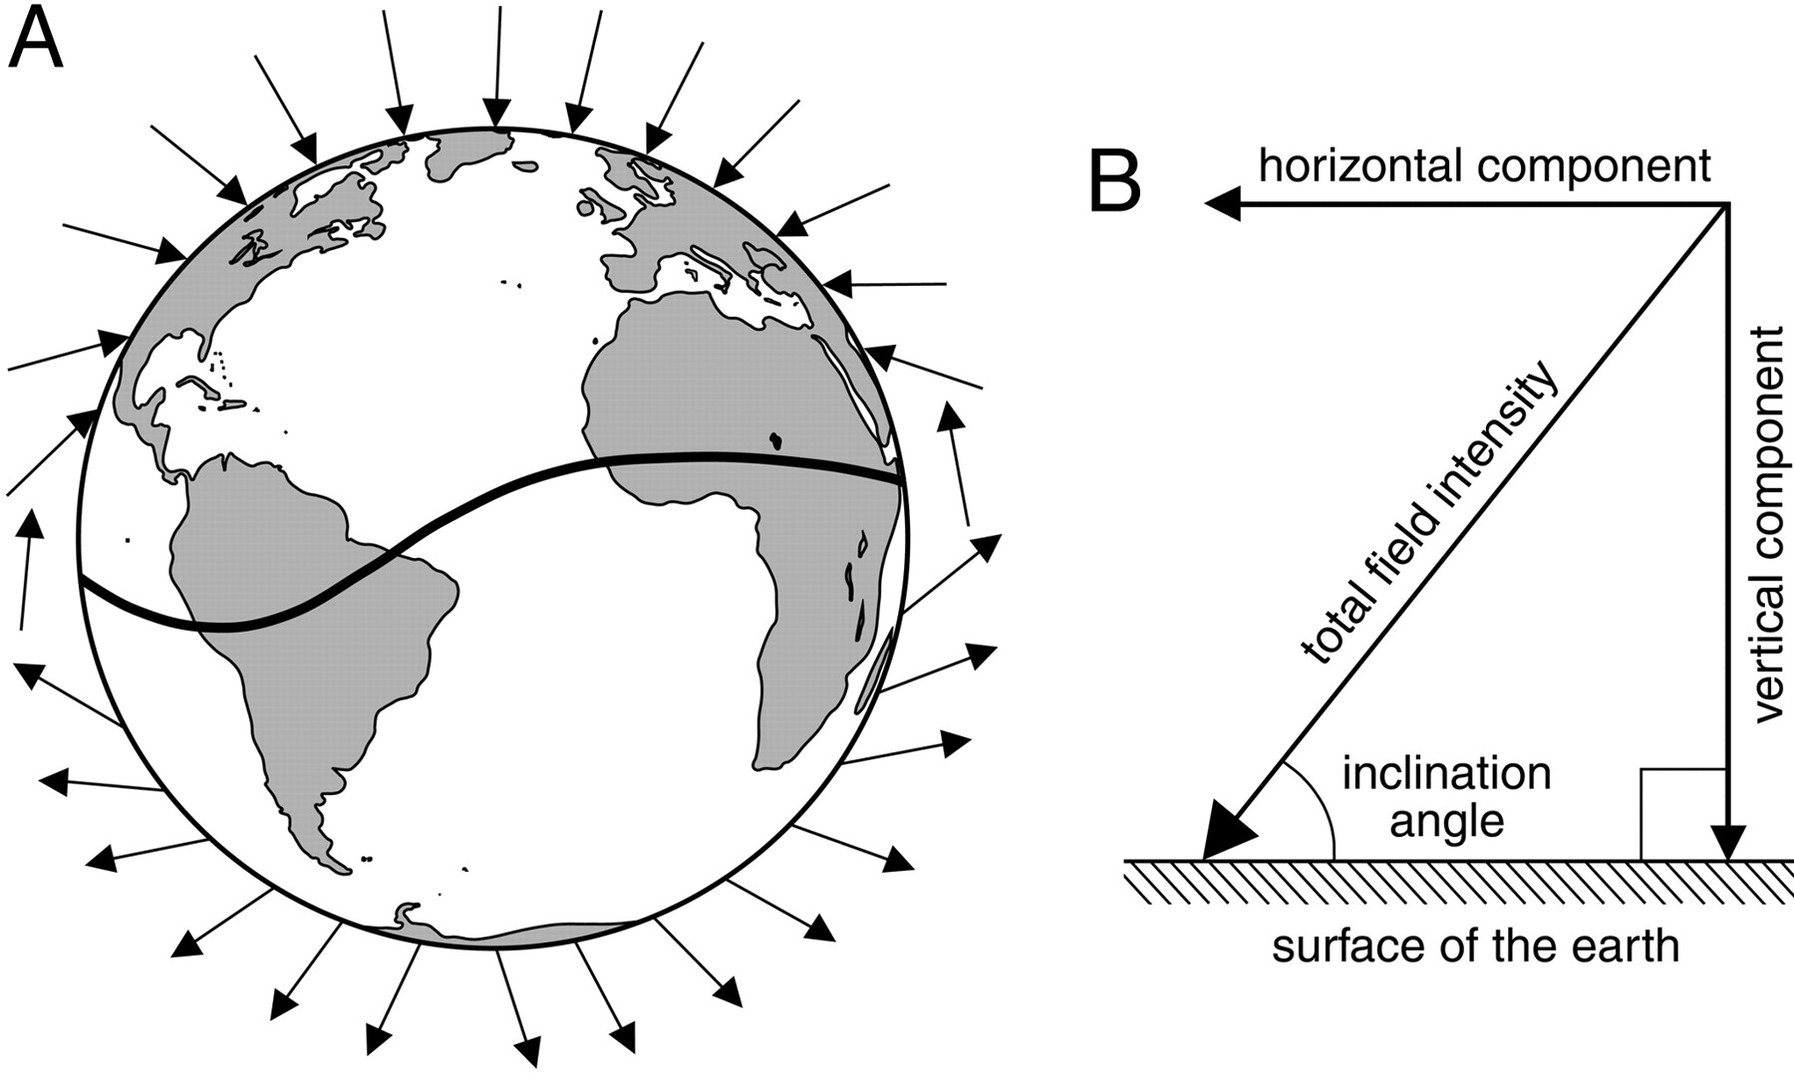



Earth's magnetic field
Measuring the Earth's magnetic field at a given location
^{Introduction and theory}
Due to the dynamism of the material that generates the magnetic field inside the planet, the location of the poles is not constant and the magnetic intensity varies at each location on Earth. Using the principle of superposition of fields, there should be considered a second field perpendicular to the field of the Earth. Here, measuring the angle of inclination of the resulting field in order to obtain a relation between both.
Earth's field
Resulting field
Coil field
Angle of inclination

Slide 9
Earth's magnetic field
Measuring the Earth's magnetic field at a given location
^{Introduction and theory}
Now, students are encouraged to propose a hypothesis to be tested by experiment.
Register the magnetic field from where you are, having first measured with a sensor facing the geographic north pole. Then face towards the geographic south pole. Do you think there would be differences between the two measurements? If so, what would the differences be?

Slide 10

Earth's magnetic field
Measuring the Earth's magnetic field at a given location
^{Activity description}
Students will use the Labdisc magnetic field sensor to perform magnetic field measurements of Earth at the place where they are; first pointing the sensor towards the geographic north pole, then reversing the orientation of the sensor by 180° to locate the magnetic field of the geographic south pole.

Slide 11
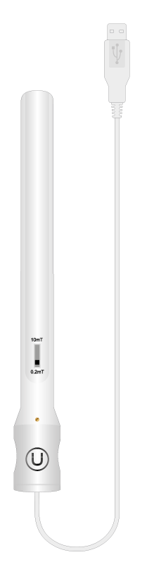
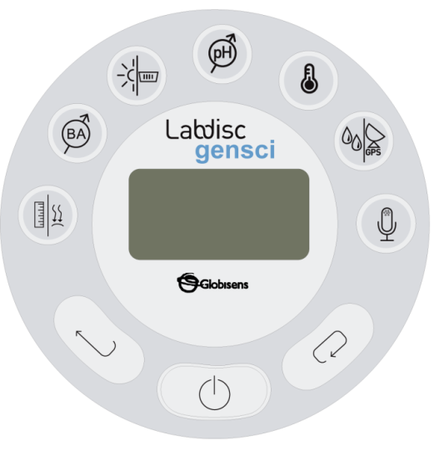

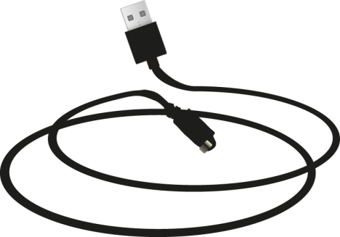
Earth's magnetic field
Measuring the Earth's magnetic field at a given location
^{Resources and materials}
Labdisc
Magnetic field sensor
USB Cable
Compass

Slide 12

Earth's magnetic field
Measuring the Earth's magnetic field at a given location
^{Using Labdisc}
^{Configuring the Labdisc}
To take samples with the magnetic field sensor, carry out the following instructions:
Connect the magnetic field sensor to the Labdisc’s universal input.
Turn on the Labdisc, and on the magnetic field sensor select 0.2 mT.
1
2

Slide 13
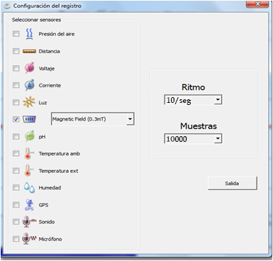
Earth's magnetic field
Measuring the Earth's magnetic field at a given location
^{Using Labdisc}
3
Click on to set the Labdisc. Select the magnetic field sensor (0.3 mT) with a frequency of 10/sec, and a total of 10000 samples.

Slide 14


Earth's magnetic field
Measuring the Earth's magnetic field at a given location
^{Using Labdisc}
4
Once you have finished configuring the sensor, start measuring by clicking .
Once you have finished measuring, stop the Labdisc by pressing .
5

Slide 15
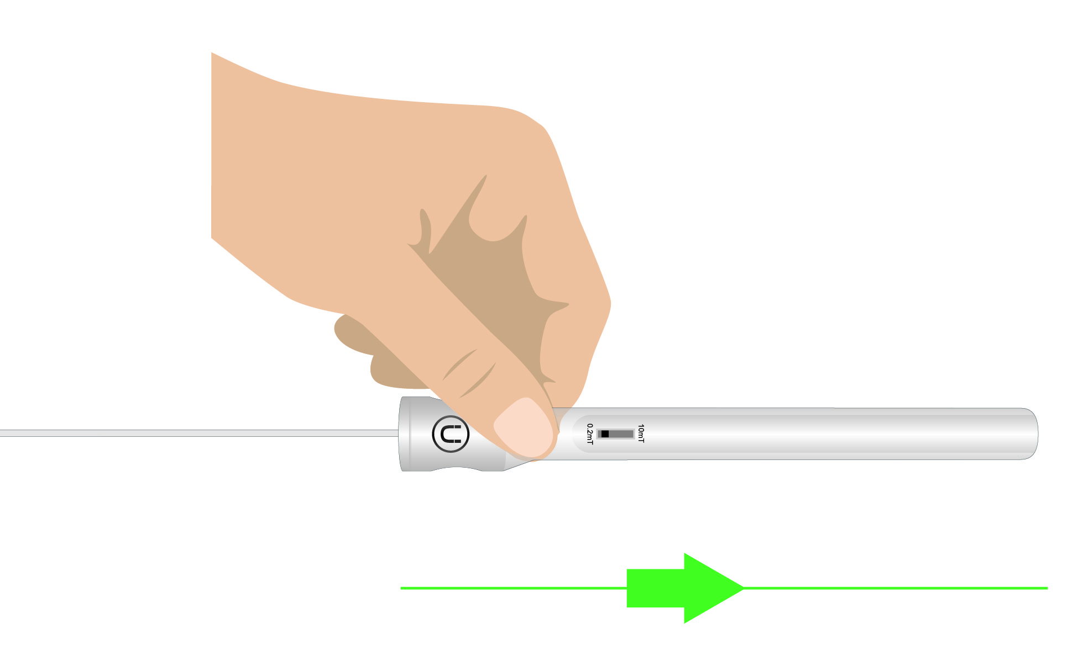
Earth's magnetic field
Measuring the Earth's magnetic field at a given location
^{Experiment}
One student holds the magnetic field sensor with one hand, using the other hand to hold the Labdisc with the screen facing up, showing the measurements.
Another student holds the compass in one hand, guiding the needle to the north.
The first student slowly moves the sensor horizontally, until the maximum value of the magnetic field is found, as shown in the figure.
Once you have found the maximum value, hold the sensor in that position.

Slide 16

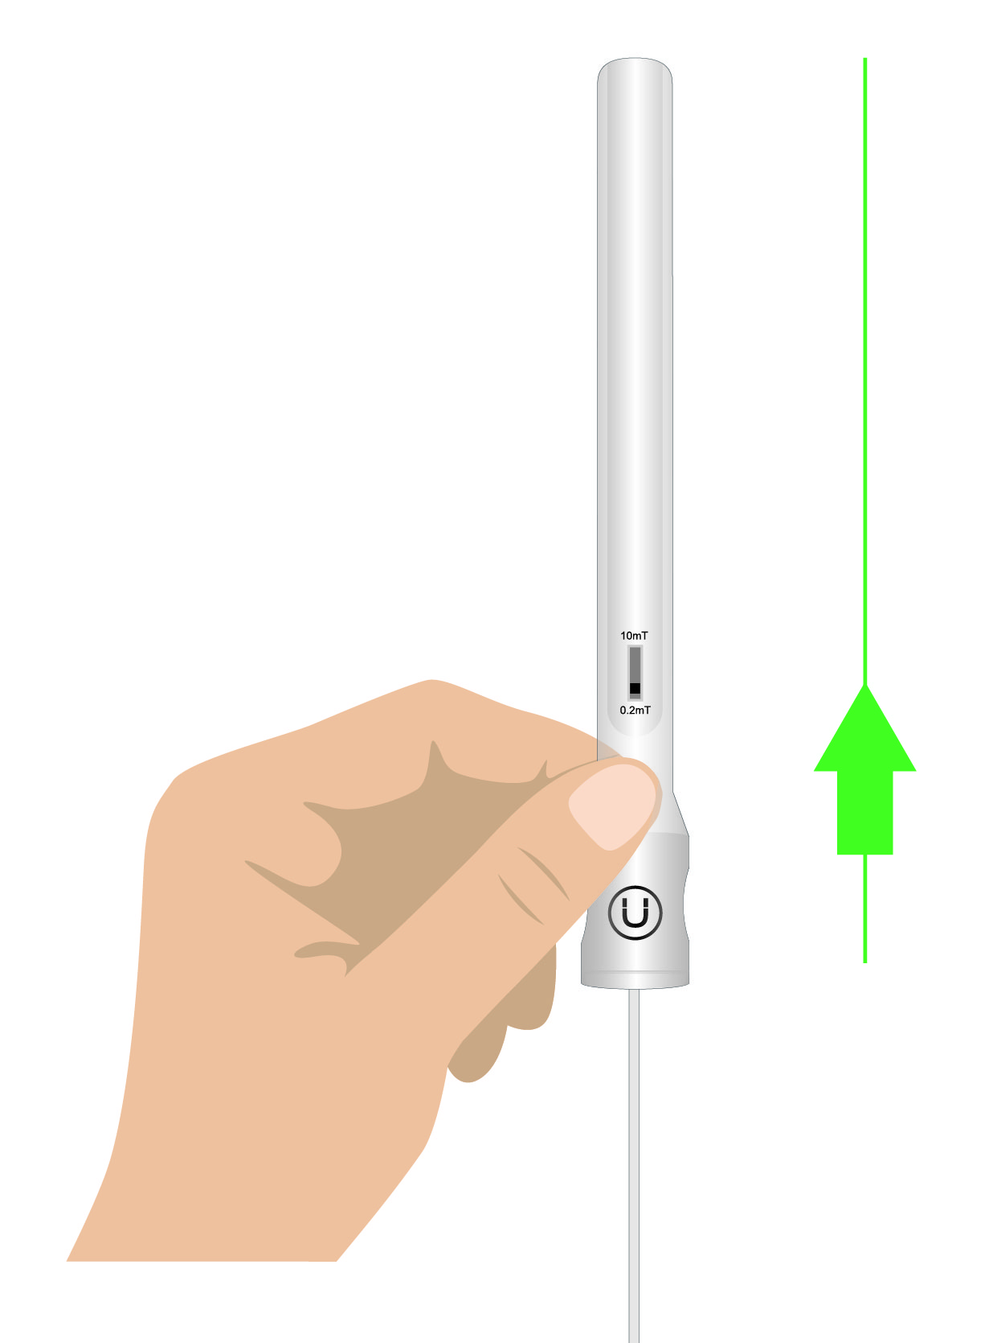
Earth's magnetic field
Measuring the Earth's magnetic field at a given location
^{Experiment}
Observe the compass and determine the orientation in which the sensor detects the maximum value of the magnetic field.
Then the student holding the sensor moves it vertically to again find the maximum value of the magnetic field, as shown in the figure.
Once again, observe the compass and determine the orientation to which the sensor points as it detects the maximum value of the magnetic field.

Slide 17


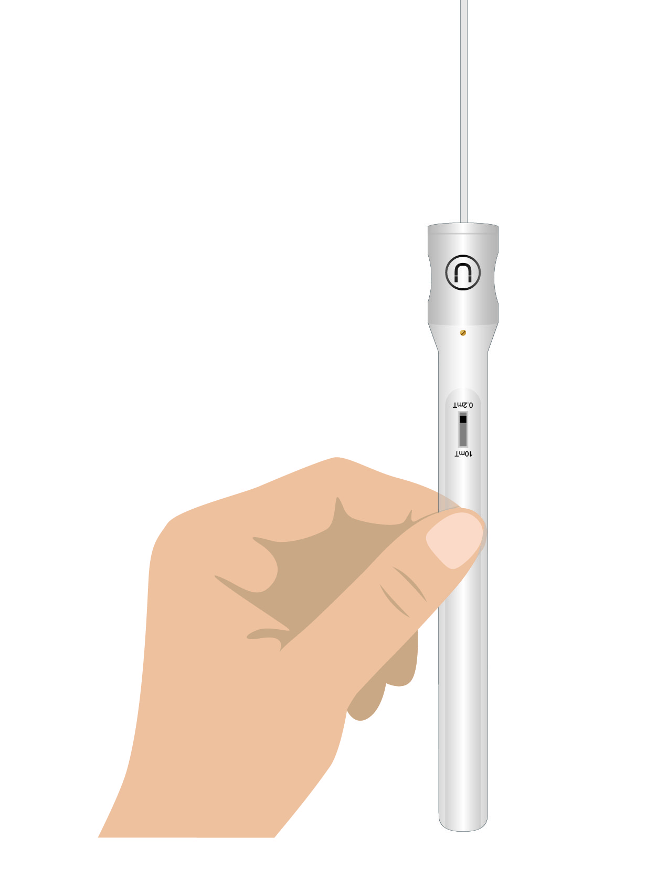
Earth's magnetic field
Measuring the Earth's magnetic field at a given location
^{Experiment}
Once you find the maximum value of the magnetic field, and have determined where the sensor aims at this point, turn the magnetic field sensor by 180°, so that it points to the opposite side, as shown in the figure.
Finally, using the compass, determine where the sensor aims at this last point.

Slide 18



Earth's magnetic field
Measuring the Earth's magnetic field at a given location
^{Results and analysis}
Connect the Labdisc to the computer and open the GlobiLab program.
At the top menu press and select .
Choose the last experiment of the list and observe the chart on the screen.
Use the button to add comments on the graph. Specify the actions that were performed during the experiment (rotating the sensor horizontally, then vertically and finally rotating it by 180°). Indicate also the direction in which the sensor was pointing when finding the maximum and minimum values ​​of the Earth's magnetic field.

Slide 19

Earth's magnetic field
Measuring the Earth's magnetic field at a given location
^{Results and analysis}
What was the maximum value of the magnetic field, and what was the minimum?
Where was the sensor pointing to obtain the maximum value and the minimum value of the magnetic field, respectively?
What is the purpose of rotating the sensor by 180°, once the maximum magnetic field is found?

Slide 20
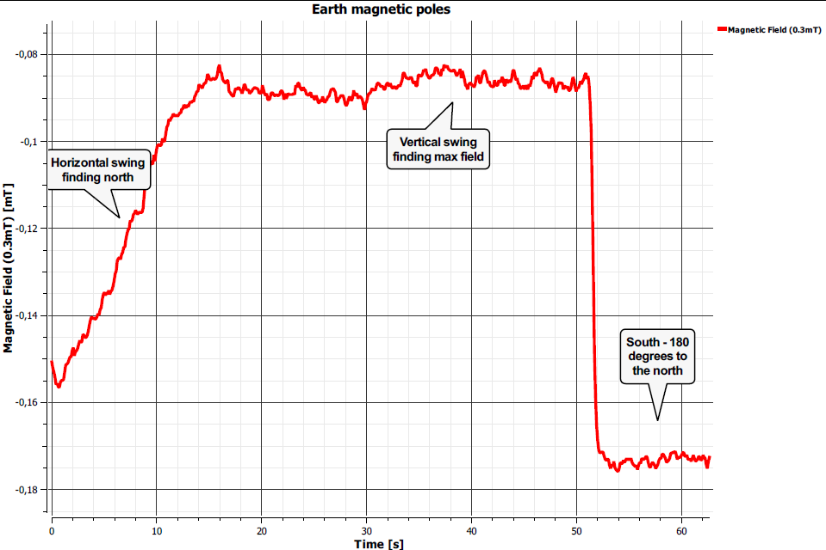
Earth's magnetic field
Measuring the Earth's magnetic field at a given location
^{Results and analysis}
The chart below should be similar to the one the students obtain:

Slide 21


Earth's magnetic field
Measuring the Earth's magnetic field at a given location
^{Application activity}
What is the relation between the magnetic poles and the geographic poles of the Earth?
It is intended that students indicate whether they obtained any relation between the magnetic and geographic poles of the Earth. Students should recognize that the greatest value of field is obtained in the magnetic north, and geographic poles are set using the compass.
What applications may have to know about the magnetic field of the Earth and issues surrounding it? Investigate the matter if you don’t know the answer.
It is intended that students indicate applications where the knowledge of magnetic fields are important, such as the use of loudspeakers and electronics in general, as well as implications in medicine, such as MRI, among others.

Slide 22
Earth's magnetic field
Measuring the Earth's magnetic field at a given location
^{Application activity}
There are certain organisms that use the magnetic field of the Earth, like the bat (Eptesicusfuscus). Why do you believe it is useful for them? If you do not know the answer, investigate the matter.
It is intended that students indicate the incidence of the magnetic field on some organisms. For example, it can be used for orientation, especially when travelling long distances.

Slide 23


